Slide 1



Welcome to
CS 345 Operating Systems
Virtual Memory (22)

Slide 2
Tip #22: Ternary Operator
The Conditional operator is mostly used in the following form:
x = (y < 0) ? 10 : 20;
But, you can also use it in the following manner:
(c < 0 ? a : b) = 1;
which means:
// If c < 0 then a = 1
// If c > 0 then b = 1
((command == "TEST") ? mode.submissionPoints : mode.bonus) +=
compareFiles(mode, mode.testOutput, mode.keyOutput, mode.testPoints, rout);

Slide 3
Linux Swap Space
It is possible to run a Linux system without a swap space.
The system will usually run well if you have a large amount of memory.
But if you run out of physical memory, the system will crash!
Best practice to have a swap space, especially since disk space is relatively cheap.
"Since I have more than enough memory available, wouldn’t it better to remove swap space completely?"
The short answer is, No - There are performance benefits when swap is enabled, even when you have more than enough ram.
With more than adequate server memory installed, you will often find that after long periods of uptime, swap space will be used.
Is it normal and maybe a good thing for Linux systems to use some swap, even if there is still available RAM?
The Linux Kernel will move memory pages which are hardly ever used into swap space to ensure that even more cachable space is made available in-memory for more frequently used memory pages (a page is a piece of memory).
Swap usage becomes a performance problem when the Kernel is pressured to continuously move memory pages in and out of memory and swap space.

Slide 4
Linux Swap Space
Another advantage is that swap gives admins time to react to low memory issues.
Some recommend no swap or swap size slightly larger than total RAM.
However, on servers, this is hardly the case and you should instead balance your decision with the effects swap will have on your specific applications.
Swap does not change the amount of RAM required for a healthy server, or desktop for that matter. It’s designed to be complimentary to performance on healthy systems.
To summarize:
Even if there is still available RAM, the Linux Kernel will move memory pages which are hardly ever used into swap space.
It’s better to swap out memory pages that have been inactive for a while, keeping often-used data in cache and this should happen when the server is most idle, which is the aim of the Kernel.
Avoid setting your swap space too large if it will result in prolonging performance issues, outages or your response time (without proper monitoring/alerts).

Slide 5
Load Before Execution?
Are executables immediately loaded into RAM when executed?
Under OS X, Windows, Linux, and iOS, the executable is mapped into the virtual address space of the process.
The CPU generates a page fault when the process accesses a mapped page of the executable that hasn't loaded into RAM.
Will a huge image file in the data section of your executable be loaded into RAM before your program first accesses it?
Only part of a huge multiple page image file will be loaded into RAM.
What is the operating system service "prefetcher"?
Under Windows (and other OS's) the prefetcher system service starts preloading into memory parts of any file that it predicts the program will access.
Predictions are based on the recorded start up access patterns of previous runs of the program.
This means parts of the executable (including DLL's and data files) will be preloaded into RAM when the process start.
Also, if the program usually displays a large image at program startup (eg. a splash screen) then the preloader will load the image into RAM whether its stored as part of the executable or as a separate data file.

Slide 6
Virtual Memory

Slide 7
Two-Level Paging System
Virtual Address
15 … 11 10 … 6 5 … 0
RPTE #
UPTE #
Frame Offset
Root Page Table
User Page Table
LC-3 Main Memory
+
Flags / Frame #
Flags / UPT #
+
Frame<<6
Offset
15 … 6 5 … 0
RPT
One per process
Physical Address

Slide 8
Virtual Memory
x0000
System
(unmapped)
Virtual Address
x2000
Non-Swappable
Frames
All tables in LC-3 memory.
All memory accesses thru getMemAdr().
RPT’s pinned.
Each process has an RPT pointer (changed on context switch).
Memory limit set by IM command.
x2400
Bit Frame Table
RPT’s (Pinned)
x3000
UPT Frames
and
Data Frames
Swappable
Frames
Paged
Swap
Space
Memory Limit
(IM command)
Unpopulated
Memory
xFFFF

Slide 9
Page Table Entry
4 bytes
 |  |  |  |  |  | Frame # (0 – 1023)
F | D | R | P | - | - | f | f | f | f | f | f | f | f | f | f
 |  |  |  | Page # (0 – 8191)
S | - | - | p | p | p | p | p | p | p | p | p | p | p | p | p
• Frame valid (1 bit): one if referenced frame is in main memory; zero otherwise.
• Dirty (1 bit): one if referenced frame has been altered; zero otherwise.
• Reference (1 bit): one if frame has been referenced; zero otherwise.
• Pinned (1 bit): one if frame is pinned in memory; zero otherwise.
• Frame number (10 bits): If referenced page is in memory, this value specifies which frame it occupies. (1024 frames × 64 words = 2¹⁰ × 2⁶ = 2¹⁶ bytes = 65536 words.)
• Swap valid (1 bit): one if referenced page has been allocated in swap space; zero otherwise.
• Swap page number (13 bits). This specifies where referenced page is stored in swap space. When you load a page into memory, you should include this value in your frame table summary. (8,192 pages × 128 bytes = 2¹³ × 2⁷ = 2²⁰ bytes = 1,048,576 bytes.)

Slide 10
Global Clock
Root Page Table
User Page Table
User Data Frame
Swapped UPTs/Data Frames
Swap Space
RPTE’s
UPTE’s
Data Frame’s

Slide 11
8 Frame Exercise

Slide 12
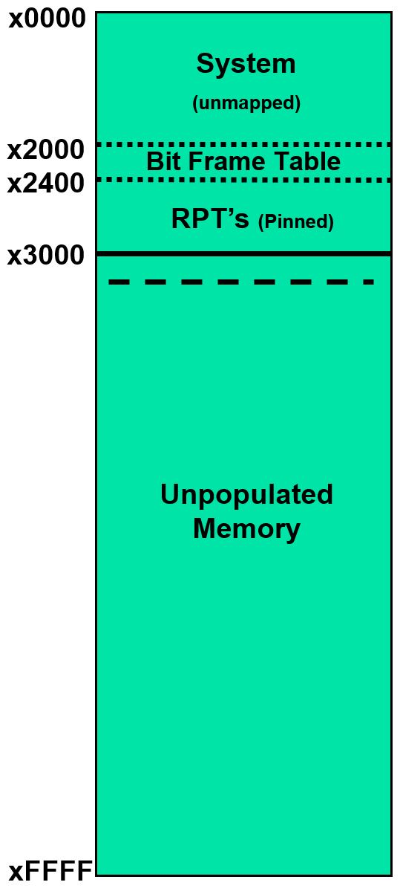
8 Frames...
FR____|S____
x3000
(192)
Frame
Page
Virtual
Address
Physical
Address
x2400
RPT0
00____|0____
00____|0____
00____|0____
00____|0____
00____|0____
00____|0____
00____|0____
00____|0____
...
00____|0____
00____|0____
00____|0____
00____|0____
00____|0____
x0000–x07FF
x0800–x0FFF
x1000–x17FF
x1800–x1FFF
x2000–x27FF
x2800–x2FFF
x3000–x37FF
x3800–x3FFF
...
xD800–xDFFF
xE000–xE7FF
xE800–xEFFF
xF000–xF7FF
xF800–xFFFF
x3040
(193)
x3080
(194)
x30C0
(195)
x3100
(196)
>>im 8
x2440
RPT1
00____|0____
00____|0____
00____|0____
00____|0____
...
x3140
(197)
x3180
(198)
x31C0
(199)
x3200

Slide 13
8 Frames...
FR____|S____
x3000
(192)
Frame
Page
00____|0____
00____|0____
...
00____|0____
x3000–x303F
x3040–x307F
...
x3780–x37FF
Virtual
Address
Physical
Address
x2400
RPT0
11_193
Disk
Storage
00____|0____
00____|0____
00____|0____
00____|0____
00____|0____
00____|0____
00____|0____
00____|0____
...
00____|0____
00____|0____
00____|0____
00____|0____
00____|0____
x0000–x07FF
x0800–x0FFF
x1000–x17FF
x1800–x1FFF
x2000–x27FF
x2800–x2FFF
x3000–x37FF
x3800–x3FFF
...
xD800–xDFFF
xE000–xE7FF
xE800–xEFFF
xF000–xF7FF
xF800–xFFFF
0x3000
⇒ 0x3040
x3040
(193)
0x3001
⇒ 0x3041
x3000-x303F
Data Frame
x3080
(194)
x240C
11_192
x30C0
(195)
x3100
(196)
x2440
RPT1
00____|0____
00____|0____
00____|0____
00____|0____
...
x3140
(197)
x3180
(198)
x31C0
(199)
x3200

Slide 14
8 Frames...
FR____|S____
x3000
(192)
Frame
Page
11_193|0____
00____|0____
...
00____|0____
Virtual
Address
Physical
Address
x2400
RPT0
00____|0____
00____|0____
00____|0____
00____|0____
00____|0____
00____|0____
11_192|0____
00____|0____
...
00____|0____
00____|0____
00____|0____
00____|0____
00____|0____
11_194
Disk
Storage
x0000–x07FF
x0800–x0FFF
x1000–x17FF
x1800–x1FFF
x2000–x27FF
x2800–x2FFF
x3000–x37FF
x3800–x3FFF
...
xD800–xDFFF
xE000–xE7FF
xE800–xEFFF
xF000–xF7FF
xF800–xFFFF
0x3000
⇒ 0x3040
x3040
(193)
0x3001
⇒ 0x3041
x3000-x303F
Data Frame
0x3040
⇒ 0x3080
0x3041
⇒ 0x3081
x3080
(194)
x3040-x307F
Data Frame
x30C0
(195)
x3100
(196)
x2440
RPT1
00____|0____
00____|0____
00____|0____
00____|0____
...
x3140
(197)
x3180
(198)
x31C0
(199)
x3200

Slide 15
8 Frames...
FR____|S____
x3000
(192)
Frame
Page
11_193|0____
11_194|0____
...
00____|0____
Virtual
Address
Physical
Address
x2400
RPT0
00____|0____
00____|0____
00____|0____
00____|0____
00____|0____
00____|0____
11_192|0____
00____|0____
...
00____|0____
00____|0____
00____|0____
00____|0____
00____|0____
Disk
Storage
x0000–x07FF
x0800–x0FFF
x1000–x17FF
x1800–x1FFF
x2000–x27FF
x2800–x2FFF
x3000–x37FF
x3800–x3FFF
...
xD800–xDFFF
xE000–xE7FF
xE800–xEFFF
xF000–xF7FF
xF800–xFFFF
0x3000
⇒ 0x3040
x3040
(193)
0x3001
⇒ 0x3041
x3000-x303F
Data Frame
0x3040
⇒ 0x3080
0x3041
⇒ 0x3081
x3080
(194)
0xEFD2
⇒ 0x3112
x3040-x307F
Data Frame
x30C0
(195)
00____|0____
00____|0____
...
00____|0____
xE800–xE83F
xE840–xE87F
...
xEF80–xEFFF
11_195
x3100
(196)
11_196
x2440
RPT1
xEF80-xEFFF
Data Frame
00____|0____
00____|0____
00____|0____
00____|0____
...
x3140
(197)
x3180
(198)
x31C0
(199)
x3200

Slide 16
8 Frames...
FR____|S____
x3000
(192)
Frame
Page
11_193|0____
11_194|0____
...
00____|0____
Virtual
Address
Physical
Address
x2400
RPT0
00____|0____
00____|0____
00____|0____
00____|0____
00____|0____
00____|0____
11_192|0____
00____|0____
...
00____|0____
00____|0____
11_195|0____
00____|0____
00____|0____
Disk
Storage
x0000–x07FF
x0800–x0FFF
x1000–x17FF
x1800–x1FFF
x2000–x27FF
x2800–x2FFF
x3000–x37FF
x3800–x3FFF
...
xD800–xDFFF
xE000–xE7FF
xE800–xEFFF
xF000–xF7FF
xF800–xFFFF
0x3000
⇒ 0x3040
x3040
(193)
0x3001
⇒ 0x3041
x3000-x303F
Data Frame
0x3040
⇒ 0x3080
0x3041
⇒ 0x3081
x3080
(194)
0xEFD2
⇒ 0x3112
x3040-x307F
Data Frame
0xD851
⇒ 0x3191
x30C0
(195)
00____|0____
00____|0____
...
11_196|0____
11_197
x3100
(196)
x2440
RPT1
xEF80-xEFFF
Data Frame
00____|0____
00____|0____
00____|0____
00____|0____
...
x3140
(197)
00____|0____
00____|0____
...
00____|0____
xD800–xD83F
xD840–xD87F
...
xDF80–xDFFF
11_198
x3180
(198)
xD840-xD87F
Data Frame
x31C0
(199)
x3200

Slide 17
8 Frames...
FR____|S____
x3000
(192)
Frame
Page
11_193|0____
11_194|0____
...
00____|0____
Virtual
Address
Physical
Address
x2400
RPT0
00____|0____
00____|0____
00____|0____
00____|0____
00____|0____
00____|0____
11_192|0____
00____|0____
...
11_197|0____
00____|0____
11_195|0____
00____|0____
00____|0____
Disk
Storage
x0000–x07FF
x0800–x0FFF
x1000–x17FF
x1800–x1FFF
x2000–x27FF
x2800–x2FFF
x3000–x37FF
x3800–x3FFF
...
xD800–xDFFF
xE000–xE7FF
xE800–xEFFF
xF000–xF7FF
xF800–xFFFF
0x3000
⇒ 0x3040
x3040
(193)
0x3001
⇒ 0x3041
x3000-x303F
Data Frame
0x3040
⇒ 0x3080
0x3041
⇒ 0x3081
x3080
(194)
0xEFD2
⇒ 0x3112
x3040-x307F
Data Frame
0xD851
⇒ 0x3191
0xD833
⇒ 0x31F3
x30C0
(195)
00____|0____
00____|0____
...
11_196|0____
x3100
(196)
x2440
RPT1
xEF80-xEFFF
Data Frame
00____|0____
00____|0____
00____|0____
00____|0____
...
x3140
(197)
00____|0____
11_198|0____
...
00____|0____
xD800–xD83F
xD840–xD87F
...
xDF80–xDFFF
11_199
x3180
(198)
xD840-xD87F
Data Frame
x31C0
(199)
xD800-xD83F
Data Frame
x3200

Slide 18
8 Frames...
FR____|S____
x3000
(192)
Frame
Page
10_193
Virtual
Address
Physical
Address
x2400
RPT0
11_193|0____
11_194|0____
...
00____|0____
Disk
Storage
00____|0____
00____|0____
00____|0____
00____|0____
00____|0____
00____|0____
11_192|0____
00____|0____
...
11_197|0____
00____|0____
11_195|0____
00____|0____
00____|0____
x0000–x07FF
x0800–x0FFF
x1000–x17FF
x1800–x1FFF
x2000–x27FF
x2800–x2FFF
x3000–x37FF
x3800–x3FFF
...
xD800–xDFFF
xE000–xE7FF
xE800–xEFFF
xF000–xF7FF
xF800–xFFFF
10_194
x0000–x07FF
x0800–x0FFF
x1000–x17FF
x1800–x1FFF
x2000–x27FF
x2800–x2FFF
x3000–x37FF
x3800–x3FFF
...
xD800–xDFFF
xE000–xE7FF
xE800–xEFFF
xF000–xF7FF
xF800–xFFFF
0x3000
⇒ 0x3040
x3040
(193)
0x3001
⇒ 0x3041
x3000-x303F
Data Frame
0x3040
⇒ 0x3080
0x3041
⇒ 0x3081
x3080
(194)
0xEFD2
⇒ 0x3112
10_192
0xD851
⇒ 0x3191
10_192
x3040-x307F
Data Frame
0xD833
⇒ 0x31F3
x30C0
(195)
0x3873
10_197
00____|0____
00____|0____
...
11_196|0____
10_197
10_195
10_195
x3100
(196)
10_196
x2440
RPT1
xEF80-xEFFF
Data Frame
00____|0____
00____|0____
00____|0____
00____|0____
...
x3140
(197)
11_199|0____
11_198|0____
...
00____|0____
10_199
Now What?
No more available frames!
10_198
x3180
(198)
xD840-xD87F
Data Frame
x31C0
(199)
xD800-xD83F
Data Frame
x3200

Slide 19
8 Frames...
FR____|S____
x3000
(192)
Frame
Page
10_193|0____
10_194|0____
...
00____|0____
Virtual
Address
Physical
Address
x2400
RPT0
0xxxxx|1___0
Disk
Storage
00____|0____
00____|0____
00____|0____
00____|0____
00____|0____
00____|0____
10_192|0____
00____|0____
...
10_197|0____
00____|0____
10_195|0____
00____|0____
00____|0____
x0000–x07FF
x0800–x0FFF
x1000–x17FF
x1800–x1FFF
x2000–x27FF
x2800–x2FFF
x3000–x37FF
x3800–x3FFF
...
xD800–xDFFF
xE000–xE7FF
xE800–xEFFF
xF000–xF7FF
xF800–xFFFF
0xxxxx|1___1
x0000–x07FF
x0800–x0FFF
x1000–x17FF
x1800–x1FFF
x2000–x27FF
x2800–x2FFF
x3000–x37FF
x3800–x3FFF
...
xD800–xDFFF
xE000–xE7FF
xE800–xEFFF
xF000–xF7FF
xF800–xFFFF
0x3000
⇒ 0x3040
x3040
(193)
00____|0____
00____|0____
...
00____|0____
x3800–x383F
x3840–x387F
...
x3F80–x3FFF
0x3001
⇒ 0x3041
x3000-x303F
Data Frame
0x3040
⇒ 0x3080
11_194
0x3041
⇒ 0x3081
x3080
(194)
0xEFD2
⇒ 0x3112
x3800-x383F
Data Frame
#0 – x3000
x3800-x383F
Data Frame
0xD851
⇒ 0x3191
x3040-x307F
Data Frame
0xD833
⇒ 0x31F3
11_193
#1 – x3040
x30C0
(195)
00____|0____
00____|0____
...
10_196|0____
0x3873
⇒ 0x30B3
x3100
(196)
x2440
RPT1
xEF80-xEFFF
Data Frame
00____|0____
00____|0____
00____|0____
00____|0____
...
x3140
(197)
10_199|0____
10_198|0____
...
00____|0____
x3180
(198)
xD840-xD87F
Data Frame
x31C0
(199)
xD800-xD83F
Data Frame
x3200

Slide 20
8 Frames...
FR____|S____
x3000
(192)
Frame
Page
0xxxxx|1___0
0xxxxx|1___1
...
00____|0____
x3000–x303F
x3040–x307F
...
x3780–x37FF
Virtual
Address
Physical
Address
x2400
RPT0
11_199|1___0
Disk
Storage
00____|0____
00____|0____
00____|0____
00____|0____
00____|0____
00____|0____
10_192|0____
11_193|0____
...
10_197|0____
00____|0____
10_195|0____
00____|0____
00____|0____
x0000–x07FF
x0800–x0FFF
x1000–x17FF
x1800–x1FFF
x2000–x27FF
x2800–x2FFF
x3000–x37FF
x3800–x3FFF
...
xD800–xDFFF
xE000–xE7FF
xE800–xEFFF
xF000–xF7FF
xF800–xFFFF
x0000–x07FF
x0800–x0FFF
x1000–x17FF
x1800–x1FFF
x2000–x27FF
x2800–x2FFF
x3000–x37FF
x3800–x3FFF
...
xD800–xDFFF
xE000–xE7FF
xE800–xEFFF
xF000–xF7FF
xF800–xFFFF
0x3000
⇒ 0x3040
x3040
(193)
00____|0____
11_194|0____
...
00____|0____
0x3001
⇒ 0x3041
x3000-x303F
Data Frame
0x3040
⇒ 0x3080
0x3041
⇒ 0x3081
x3080
(194)
0xEFD2
⇒ 0x3112
11_192
x3800-x383F
Data Frame
#0 – x3000
0xD851
⇒ 0x3191
x3040-x307F
Data Frame
0xD833
⇒ 0x31F3
10_193
#1 – x3040
x30C0
(195)
00____|0____
00____|0____
...
10_196|0____
#2 – xD800
0x3873
⇒ 0x30B3
0x3000
⇒ 0x31C0
x3100
(196)
x2440
RPT1
xEF80-xEFFF
Data Frame
00____|0____
00____|0____
00____|0____
00____|0____
...
x3140
(197)
10_199|0____
10_198|0____
...
00____|0____
0xxxxx|1___2
x3180
(198)
xD840-xD87F
Data Frame
x31C0
(199)
xD800-xD83F
Data Frame
x3000-x303F
Data Frame
x3200

Slide 21
8 Frames...
FR____|S____
x3000
(192)
Frame
Page
11_199|1___0
0xxxxx|1___1
...
00____|0____
Virtual
Address
Physical
Address
x2400
RPT0
00____|0____
00____|0____
00____|0____
00____|0____
00____|0____
00____|0____
11_192|0____
10_193|0____
...
10_197|0____
00____|0____
10_195|0____
00____|0____
00____|0____
Disk
Storage
x0000–x07FF
x0800–x0FFF
x1000–x17FF
x1800–x1FFF
x2000–x27FF
x2800–x2FFF
x3000–x37FF
x3800–x3FFF
...
xD800–xDFFF
xE000–xE7FF
xE800–xEFFF
xF000–xF7FF
xF800–xFFFF
x0000–x07FF
x0800–x0FFF
x1000–x17FF
x1800–x1FFF
x2000–x27FF
x2800–x2FFF
x3000–x37FF
x3800–x3FFF
...
xD800–xDFFF
xE000–xE7FF
xE800–xEFFF
xF000–xF7FF
xF800–xFFFF
0x3000
⇒ 0x3040
x3040
(193)
00____|0____
11_194|0____
...
00____|0____
0x3001
⇒ 0x3041
x3000-x303F
Data Frame
0x3040
⇒ 0x3080
0x3041
⇒ 0x3081
x3080
(194)
0xEFD2
⇒ 0x3112
x3800-x383F
Data Frame
#0 – x3000
0xD851
⇒ 0x3191
x3040-x307F
Data Frame
0xD833
⇒ 0x31F3
x30C0
(195)
#1 – x3040
0x3873
⇒ 0x30B3
0xxxxx|1___4
00____|0____
00____|0____
...
10_196|0____
#2 – xD800
0x3000
⇒ 0x31C0
#3 – xD840
0xF7C5
⇒ 0x3145
x3100
(196)
#4 – UPT1
11_198
x2440
RPT1
xEF80-xEFFF
Data Frame
00____|0____
00____|0____
00____|0____
00____|0____
...
x3140
(197)
0xxxxx|1___2
10_198|0____
...
00____|0____
xF740-xF7FF
Data Frame
0xxxxx|1___3
x3180
(198)
00____|0____
00____|0____
...
00____|0____
xF000–xF03F
xF040–xF07F
...
xF740–xF7FF
xD840-xD87F
Data Frame
x31C0
(199)
11_197
x3000-x303F
Data Frame
x3200

Slide 22
8 Frames...
FR____|S____
x3000
(192)
Frame
Page
11_199|1___0
0xxxxx|1___1
...
00____|0____
Virtual
Address
Physical
Address
x2400
RPT0
00____|0____
00____|0____
00____|0____
00____|0____
00____|0____
00____|0____
11_192|0____
10_193|0____
...
0xxxxx|1___4
00____|0____
10_195|0____
11_198|0____
00____|0____
Disk
Storage
x0000–x07FF
x0800–x0FFF
x1000–x17FF
x1800–x1FFF
x2000–x27FF
x2800–x2FFF
x3000–x37FF
x3800–x3FFF
...
xD800–xDFFF
xE000–xE7FF
xE800–xEFFF
xF000–xF7FF
xF800–xFFFF
x0000–x07FF
x0800–x0FFF
x1000–x17FF
x1800–x1FFF
x2000–x27FF
x2800–x2FFF
x3000–x37FF
x3800–x3FFF
...
xD800–xDFFF
xE000–xE7FF
xE800–xEFFF
xF000–xF7FF
xF800–xFFFF
0x3000
⇒ 0x3040
x3040
(193)
00____|0____
11_194|0____
...
00____|0____
0x3001
⇒ 0x3041
x3000-x303F
Data Frame
0x3040
⇒ 0x3080
0x3041
⇒ 0x3081
x3080
(194)
0xEFD2
⇒ 0x3112
x3800-x383F
Data Frame
#0 – x3000
0xD851
⇒ 0x3191
x3040-x307F
Data Frame
0xD833
⇒ 0x31F3
x30C0
(195)
#1 – x3040
0x3873
⇒ 0x30B3
00____|0____
00____|0____
...
10_196|0____
xE800–xE83F
xE840–xE87F
...
xEF80–xEFFF
#2 – xD800
0x3000
⇒ 0x31C0
#3 – xD840
0xF7C5
⇒ 0x3145
11_195
x3100
(196)
11_196
#4 – UPT1
0xEFF0
⇒ 0x3130
x2440
RPT1
xEF80-xEFFF
Data Frame
00____|0____
00____|0____
00____|0____
00____|0____
...
x3140
(197)
0xxxxx|1___2
10_198|0____
...
00____|0____
xF740-xF7FF
Data Frame
Is every frame accounted for?
x3180
(198)
00____|0____
00____|0____
...
11_197|0____
x31C0
(199)
x3000-x303F
Data Frame
x3200

Slide 23
8 Frames...
FR____|S____
x3000
(192)
Frame
Page
10_199
Virtual
Address
Physical
Address
x2400
RPT0
11_199|1___0
0xxxxx|1___1
...
00____|0____
Disk
Storage
00____|0____
00____|0____
00____|0____
00____|0____
00____|0____
00____|0____
11_192|0____
10_193|0____
...
0xxxxx|1___4
00____|0____
11_195|0____
11_198|0____
00____|0____
x0000–x07FF
x0800–x0FFF
x1000–x17FF
x1800–x1FFF
x2000–x27FF
x2800–x2FFF
x3000–x37FF
x3800–x3FFF
...
xD800–xDFFF
xE000–xE7FF
xE800–xEFFF
xF000–xF7FF
xF800–xFFFF
x0000–x07FF
x0800–x0FFF
x1000–x17FF
x1800–x1FFF
x2000–x27FF
x2800–x2FFF
x3000–x37FF
x3800–x3FFF
...
xD800–xDFFF
xE000–xE7FF
xE800–xEFFF
xF000–xF7FF
xF800–xFFFF
0x3000
⇒ 0x3040
x3040
(193)
00____|0____
11_194|0____
...
00____|0____
0x3001
⇒ 0x3041
x3000-x303F
Data Frame
xD800-xD83F
Data Frame
10_194
0x3040
⇒ 0x3080
0xxxxx|1___5
0x3041
⇒ 0x3081
x3080
(194)
0xxxxx|1___2
0xxxxx|1___3
...
00____|0____
xD800–xD83F
xD840–xD87F
...
xDF80–xDFFF
0xEFD2
⇒ 0x3112
11_193
#0 – x3000
10_192
x3800-x383F
Data Frame
0xD851
⇒ 0x3191
x3040-x307F
Data Frame
0xD833
⇒ 0x31F3
0xxxxx|1___6
#1 – x3040
x30C0
(195)
00____|0____
00____|0____
...
11_196|0____
#2 – xD800
0x3873
⇒ 0x30B3
11_194
0x3000
⇒ 0x31C0
#3 – xD840
0xF7C5
⇒ 0x3145
10_195
x3100
(196)
10_196
#4 – UPT1
0xEFF0
⇒ 0x3130
10_198
#5 – x3800
0xD807
⇒ 0x3047
xEF80-xEFFF
Data Frame
x2440
RPT1
00____|0____
00____|0____
00____|0____
00____|0____
...
#6 – UPT2
x3140
(197)
0xxxxx|1___2
10_198|0____
...
00____|0____
xF740-xF7FF
Data Frame
x3180
(198)
00____|0____
00____|0____
...
11_197|0____
x31C0
(199)
10_197
x3000-x303F
Data Frame
x3200

Slide 24
8 Frames... 0x3040 ⇨ ??
FR____|S____
x3000
(192)
Frame
Page
10_199|1___0
0xxxxx|1___1
...
00____|0____
Virtual
Address
Physical
Address
x2400
RPT0
00____|0____
00____|0____
00____|0____
00____|0____
00____|0____
00____|0____
10_192|0____
0xxxxx|1___6
...
11_194|1___4
00____|0____
10_195|0____
10_198|0____
00____|0____
Disk
Storage
x0000–x07FF
x0800–x0FFF
x1000–x17FF
x1800–x1FFF
x2000–x27FF
x2800–x2FFF
x3000–x37FF
x3800–x3FFF
...
xD800–xDFFF
xE000–xE7FF
xE800–xEFFF
xF000–xF7FF
xF800–xFFFF
x0000–x07FF
x0800–x0FFF
x1000–x17FF
x1800–x1FFF
x2000–x27FF
x2800–x2FFF
x3000–x37FF
x3800–x3FFF
...
xD800–xDFFF
xE000–xE7FF
xE800–xEFFF
xF000–xF7FF
xF800–xFFFF
0x3000
⇒ 0x3040
x3040
(193)
0x3001
⇒ 0x3041
xD800-xD83F
Data Frame
0x3040
⇒ 0x3080
0x3041
⇒ 0x3081
x3080
(194)
11_193|1___2
0xxxxx|1___3
...
00____|0____
0xEFD2
⇒ 0x3112
#0 – x3000
0xD851
⇒ 0x3191
#1 – x3040
0xD833
⇒ 0x31F3
x30C0
(195)
0x3873
⇒ 0x30B3
00____|0____
00____|0____
...
10_196|0____
#2 – xD800
0x3000
⇒ 0x31C0
#3 – xD840
0xF7C5
⇒ 0x3145
x3100
(196)
#4 – UPT1
0xEFF0
⇒ 0x3130
#5 – x3800
0xD807
⇒ 0x3047
xEF80-xEFFF
Data Frame
0x3040
x2440
RPT1
00____|0____
00____|0____
00____|0____
00____|0____
...
#6 – UPT2
x3140
(197)
xF740-xF7FF
Data Frame
x3180
(198)
00____|0____
00____|0____
...
10_197|0____
x31C0
(199)
x3000-x303F
Data Frame
x3200

Slide 25
8 Frames...
FR____|S____
x3000
(192)
Frame
Page
10_199|1___0
0xxxxx|1___1
...
00____|0____
Virtual
Address
Physical
Address
x2400
RPT0
00____|0____
00____|0____
00____|0____
00____|0____
00____|0____
00____|0____
10_192|0____
0xxxxx|1___6
...
11_194|1___4
00____|0____
10_195|0____
10_198|0____
00____|0____
11_196|1___1
Disk
Storage
x0000–x07FF
x0800–x0FFF
x1000–x17FF
x1800–x1FFF
x2000–x27FF
x2800–x2FFF
x3000–x37FF
x3800–x3FFF
...
xD800–xDFFF
xE000–xE7FF
xE800–xEFFF
xF000–xF7FF
xF800–xFFFF
x0000–x07FF
x0800–x0FFF
x1000–x17FF
x1800–x1FFF
x2000–x27FF
x2800–x2FFF
x3000–x37FF
x3800–x3FFF
...
xD800–xDFFF
xE000–xE7FF
xE800–xEFFF
xF000–xF7FF
xF800–xFFFF
0x3000
⇒ 0x3040
x3040
(193)
0x3001
⇒ 0x3041
xD800-xD83F
Data Frame
0x3040
⇒ 0x3080
0x3041
⇒ 0x3081
x3080
(194)
11_193|1___2
0xxxxx|1___3
...
00____|0____
0xEFD2
⇒ 0x3112
11_192
#0 – x3000
0xD851
⇒ 0x3191
#1 – x3040
0xD833
⇒ 0x31F3
x30C0
(195)
0x3873
⇒ 0x30B3
10_194
00____|0____
00____|0____
...
10_196|0____
#2 – xD800
0x3000
⇒ 0x31C0
#3 – xD840
0xF7C5
⇒ 0x3145
x3100
(196)
0xxxxx|1___7
#4 – UPT1
0xEFF0
⇒ 0x3130
#5 – x3800
0xD807
⇒ 0x3047
x3040-x307F
Data Frame
x2440
RPT1
xEF80-xEFFF
Data Frame
#6 – UPT2
0x3040
⇒ 0x3100
00____|0____
00____|0____
00____|0____
00____|0____
...
x3140
(197)
#7 – xEF80
xF740-xF7FF
Data Frame
x3180
(198)
00____|0____
00____|0____
...
10_197|0____
x31C0
(199)
x3000-x303F
Data Frame
x3200

Slide 26
8 Frames...
FR____|S____
x3000
(192)
Frame
Page
10_199|1___0
11_196|1___1
...
00____|0____
Virtual
Address
Physical
Address
x2400
RPT0
00____|0____
00____|0____
00____|0____
00____|0____
00____|0____
00____|0____
11_192|0____
0xxxxx|1___6
...
10_194|1___4
00____|0____
10_195|0____
10_198|0____
00____|0____
Disk
Storage
x0000–x07FF
x0800–x0FFF
x1000–x17FF
x1800–x1FFF
x2000–x27FF
x2800–x2FFF
x3000–x37FF
x3800–x3FFF
...
xD800–xDFFF
xE000–xE7FF
xE800–xEFFF
xF000–xF7FF
xF800–xFFFF
x0000–x07FF
x0800–x0FFF
x1000–x17FF
x1800–x1FFF
x2000–x27FF
x2800–x2FFF
x3000–x37FF
x3800–x3FFF
...
xD800–xDFFF
xE000–xE7FF
xE800–xEFFF
xF000–xF7FF
xF800–xFFFF
0x3000
⇒ 0x3040
x3040
(193)
0x3001
⇒ 0x3041
xD800-xD83F
Data Frame
0x3040
⇒ 0x3080
0x3041
⇒ 0x3081
x3080
(194)
11_193|1___2
0xxxxx|1___3
...
00____|0____
0xEFD2
⇒ 0x3112
#0 – x3000
0xD851
⇒ 0x3191
#1 – x3040
0xD833
⇒ 0x31F3
x30C0
(195)
00____|0____
00____|0____
...
0xxxxx|1___7
#2 – xD800
0x3873
⇒ 0x30B3
00____|0____
00____|0____
...
00____|0____
0x3000
⇒ 0x31C0
#3 – xD840
0xF7C5
⇒ 0x3145
0xxxxx|1___8
x3100
(196)
11_197|0____
#4 – UPT1
0xEFF0
⇒ 0x3130
#5 – x3800
0xD807
⇒ 0x3047
11_195
x3040-x307F
Data Frame
0x3040
⇒ 0x3100
x2440
RPT1
00____|0____
00____|0____
00____|0____
00____|0____
...
#6 – UPT2
0xFFC8
⇒ 0x3148
x3140
(197)
#7 – xEF80
xFFC0-xFFFF
Data Frame
#8 – UPT3
xF740-xF7FF
Data Frame
x3180
(198)
#9 – F740
00____|0____
00____|0____
...
10_197|0____
x31C0
(199)
0xxxxx|1___9
x3000-x303F
Data Frame
x3200

Slide 27
8 Frames...
FR____|S____
x3000
(192)
Frame
Page
10_199|1___0
11_196|1___1
...
00____|0____
Virtual
Address
Physical
Address
x2400
RPT0
11_199|1___0
Disk
Storage
00____|0____
00____|0____
00____|0____
00____|0____
00____|0____
00____|0____
11_192|0____
0xxxxx|1___6
...
10_194|1___4
00____|0____
0xxxxx|1___8
10_198|0____
11_195|0____
x0000–x07FF
x0800–x0FFF
x1000–x17FF
x1800–x1FFF
x2000–x27FF
x2800–x2FFF
x3000–x37FF
x3800–x3FFF
...
xD800–xDFFF
xE000–xE7FF
xE800–xEFFF
xF000–xF7FF
xF800–xFFFF
x0000–x07FF
x0800–x0FFF
x1000–x17FF
x1800–x1FFF
x2000–x27FF
x2800–x2FFF
x3000–x37FF
x3800–x3FFF
...
xD800–xDFFF
xE000–xE7FF
xE800–xEFFF
xF000–xF7FF
xF800–xFFFF
0x3000
⇒ 0x3040
x3040
(193)
0x3001
⇒ 0x3041
xD800-xD83F
Data Frame
0x3040
⇒ 0x3080
0x3041
⇒ 0x3081
x3080
(194)
11_193|1___2
0xxxxx|1___3
...
00____|0____
0xEFD2
⇒ 0x3112
#0 – x3000
0xD851
⇒ 0x3191
#1 – x3040
0xD833
⇒ 0x31F3
x30C0
(195)
0x3873
⇒ 0x30B3
00____|0____
00____|0____
...
11_197|0____
#2 – xD800
0x3000
⇒ 0x31C0
#3 – xD840
0xF7C5
⇒ 0x3145
x3100
(196)
#4 – UPT1
0xEFF0
⇒ 0x3130
#5 – x3800
0xD807
⇒ 0x3047
x3040-x307F
Data Frame
0x3040
⇒ 0x3100
x2440
RPT1
00____|0____
00____|0____
00____|0____
00____|0____
...
#6 – UPT2
0xFFC8
⇒ 0x3148
x3140
(197)
#7 – xEF80
0x303C
⇒ 0x31FC
xFFC0-xFFFF
Data Frame
#8 – UPT3
xF740-xF7FF
Data Frame
x3180
(198)
#9 – F740
00____|0____
00____|0____
...
0xxxxx|1___9
x31C0
(199)
x3000-x303F
Data Frame
x3200

Slide 28
8 Frames...
FR____|S____
x3000
(192)
Frame
Page
11_199|1___0
11_196|1___1
...
00____|0____
Virtual
Address
Physical
Address
x2400
RPT0
10_199
Disk
Storage
00____|0____
00____|0____
00____|0____
00____|0____
00____|0____
00____|0____
11_192|0____
0xxxxx|1___6
...
10_194|1___4
00____|0____
0xxxxx|1___8
10_198|0____
11_195|0____
x0000–x07FF
x0800–x0FFF
x1000–x17FF
x1800–x1FFF
x2000–x27FF
x2800–x2FFF
x3000–x37FF
x3800–x3FFF
...
xD800–xDFFF
xE000–xE7FF
xE800–xEFFF
xF000–xF7FF
xF800–xFFFF
10_196
x0000–x07FF
x0800–x0FFF
x1000–x17FF
x1800–x1FFF
x2000–x27FF
x2800–x2FFF
x3000–x37FF
x3800–x3FFF
...
xD800–xDFFF
xE000–xE7FF
xE800–xEFFF
xF000–xF7FF
xF800–xFFFF
0x3000
⇒ 0x3040
x3040
(193)
0x3001
⇒ 0x3041
xF000-xF03F
Data Frame
0x3040
⇒ 0x3080
xD800-xD83F
Data Frame
0x3041
⇒ 0x3081
x3080
(194)
11_193|1___2
0xxxxx|1___3
...
00____|0____
10_193
0xEFD2
⇒ 0x3112
10_192
0xxxxx
#0 – x3000
0xD851
⇒ 0x3191
#1 – x3040
0xD833
⇒ 0x31F3
x30C0
(195)
0x3873
⇒ 0x30B3
00____|0____
00____|0____
...
11_197|0____
#2 – xD800
0x3000
⇒ 0x31C0
#3 – xD840
0xF7C5
⇒ 0x3145
x3100
(196)
10_197
#4 – UPT1
0xEFF0
⇒ 0x3130
11_198
11_198
10_198
#5 – x3800
0xD807
⇒ 0x3047
10_195
x3040-x307F
Data Frame
0x3040
⇒ 0x3100
x2440
RPT1
00____|0____
00____|0____
00____|0____
00____|0____
...
#6 – UPT2
0xFFC8
⇒ 0x3148
x3140
(197)
#7 – xEF80
0x303C
⇒ 0x31FC
xFFC0-xFFFF
Data Frame
#8 – UPT3
xF740-xF7FF
Data Frame
0xF000
⇒ 0x3040
#9 – F740
x3180
(198)
00____|0____
00____|0____
...
0xxxxx|1___9
11_193
x31C0
(199)
x3000-x303F
Data Frame
x3200

Slide 29
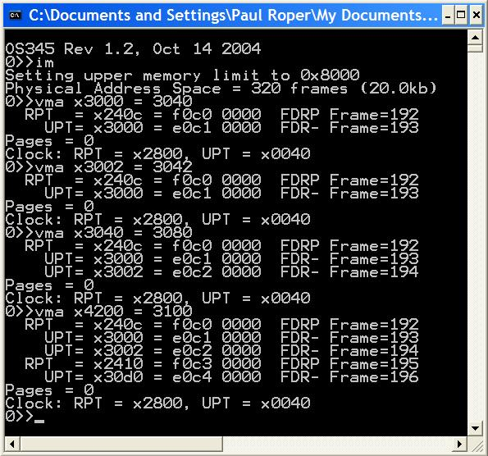
vma
2 frames – UPT, Frame
No new frames
Same UPT, new Frame
No swap pages
New UPT, new Frame
Clock did not advance

Slide 30
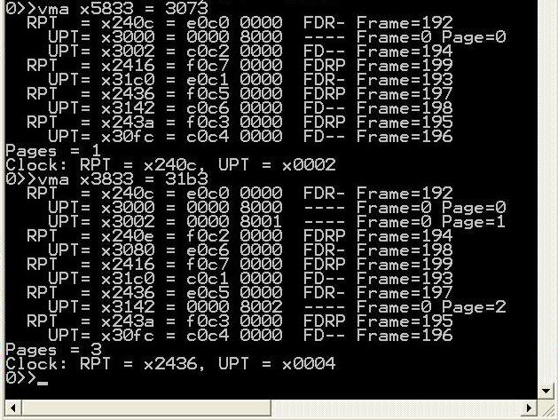
vma

Slide 31
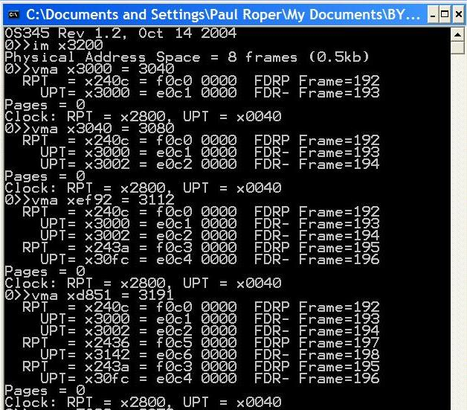
Implementation Demo
Notes:
31

Slide 32
vma
2 frames – UPT, Frame
No new frames
Same UPT, new Frame
No swap pages
New UPT, new Frame
Clock did not advance

Slide 33
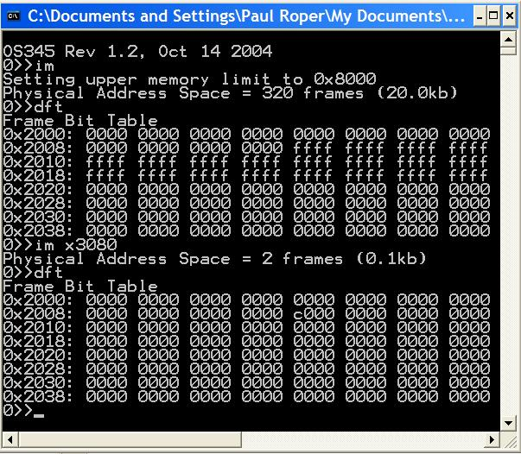
Frame Bit Table
0x3000
0x8000
2 Frames

Slide 34
accessPage
// *************************************************************************
// read/write to swap space
int accessPage(int pnum, int frame, int rwnFlg)
{ static int nextPage; // swap page size
static int pageReads; // page reads
static int pageWrites; // page writes
static unsigned short int swapMemory[LC3_MAX_SWAP_MEMORY];
if ((nextPage >= LC3_MAX_PAGE) ||
(pnum >= LC3_MAX_PAGE))
{
printf("\nVirtual Memory Space Exceeded! (%d)",
LC3_MAX_PAGE);
exit(-4);
}
switch(rwnFlg)
{
case PAGE_INIT: // init paging
clockRPT = 0; // clear RPT clock
clockUPT = 0; // clear UPT clock
memAccess = 0; // memory accesses
memHits = 0; // memory hits
memPageFaults = 0; // memory faults
nextPage = 0; // disk swap space size
pageReads = 0; // disk page reads
pageWrites = 0; // disk page writes
return 0;
case PAGE_GET_SIZE: // return swap size
return nextPage;
case PAGE_GET_READS: // return swap reads
return pageReads;
case PAGE_GET_WRITES: // return swap writes
return pageWrites;
case PAGE_GET_ADR: // return page address
return (int)(&swapMemory[pnum<<6]);
case PAGE_NEW_WRITE: // new write
pnum = nextPage++;
case PAGE_OLD_WRITE: // write
memcpy(&swapMemory[pnum<<6],
&memory[frame<<6], 1<<7);
pageWrites++;
return pnum;
case PAGE_READ: // read
memcpy(&memory[frame<<6],
&swapMemory[pnum<<6], 1<<7);
pageReads++;
return pnum;
case PAGE_FREE: // free page
printf("\nPAGE_FREE not implemented");
break;
}
return pnum;
} // end accessPage

Slide 35
Virtual Memory Guidelines
Verify a clean compilation of your LC-3 virtual memory simulator. Validate that “crawler.hex” and “memtest.hex” programs execute properly.
Modify the getMemAdr() function to handle a 2-level, paging, virtual memory addressing.
Implement a clock page replacement algorithm to pick which frame is unloaded, if necessary, on a page fault.
Use the provided 1MB page swap table routine to simulate paged disk storage (8192 pages) or implement your own routine.
Use crawler.hex and memtest.hex to validate your virtual memory implementation. Use other routines (such as im) to debug you implementation.

Slide 36
Virtual Memory Guidelines
Use the following CLI commands to verify and validate your virtual memory system. (Most of these routines are provided, but may require some adaptation to your system.)
dfm <#> Display LC3 memory frame <#>
dft Display frame allocation table
dm <sa>,<ea> Display physical LC3 memory from <sa> to <ea>
dp <#> Display page <#> in swap space
dv <sa>,<ea> Display virtual LC3 memory <sa> to <ea>
im <#> Init LC3/Set upper LC3 memory limit
rpt <#> Display task <#> root page table
upt <p><#> Display task <p> user page table <#>
vma <a> Access <a> and display RPTE’s and UPTE’s
vms Display LC3 statistics

Slide 37
Virtual Memory Guidelines
Demonstrate that LC-3 tasks run correctly. Be able to dynamically change LC-3 memory size (im command) and chart resulting changes in page hits/faults. Memory accesses, hits and faults are defined as follows:
Memory access (memAccess) = sum of memory hits (memHits) and memory faults (memPageFaults).
Hit (memHits) = access to task RPT, UPT, or data frame. (Exclude accesses below 0x3000.)
Fault (memPageFaults) = access to a task page that is undefined or not currently in a memory frame.
Page Reads (pageReads) = # pages read from swap space into memory.
Page Writes (pageWrites) = # pages written from memory to swap space.
Swap Page (nextPage) = # of swap space pages currently allocated to swapped pages.
 | Crawler |  |  | Memtest
Frames: | 320 | 16 | 2 | 320 | 16 | 2
Accesses:
Hits:
Faults:
Page Reads:
Page Writes:
Swap Pages:

Slide 38
Project 4 Grading Criteria
REQUIRED:
8 pts – Successfully execute crawler and memtest in 20k words (320 frames).
6 pts – Successfully execute crawler and memtest in 1k words (16 frames).
2 pts – Successfully execute 5 or more LC-3 tasks simultaneously in 16 frames of LC-3 memory.
2 pts – Correctly use the dirty bit to only write altered or new memory frames to swap space.
2 pts – Chart and submit the resulting memory access, hit, fault, and swap page statistics after executing crawler (and then memtest) in 320 and 16 frames.
BONUS:
+2 points – early pass-off (at least one day before due date.)
+2 points – Add a per/task frame/swap page recovery mechanism of a terminated task.
+1 point – Implement the advanced clock algorithm (Stallings, pp. 372-373).
+1 point – Implement an additional replacement policy and chart the results.
+2 points – Join the 2-frame club. (Successfully execute 5 or more LC-3 tasks simultaneously in
2 frames of LC-3 memory. Chart the memory accesses, hits, and faults.)
–2 points penalty for each school day late.

Slide 39
Steps to Success
Read and comprehend Stallings, Section 8.1.
Comprehend the lab specs.
Discuss questions with classmates, the TA’s and/or the professor.
Make sure you understand what the requirements are!
It's a tragedy to code for 20 hours and then realize you're doing everything wrong.
Validate that the demo LC-3 simulator works for a single task with pass-through addressing (virtual equals physical) for the LC-3 by executing the commands “crawler” and “memtest”.
Design your MMU. Break the problem down into manageable parts.
Create and validate a “clock” mechanism that accesses all global root page tables, user page tables, and data frames.
Implement dirty bit last – use “write-through” for all swapping of a data frame to swap space.

Slide 40
So…
Incrementally add support for the actual translation of virtual addresses to physical addresses with page fault detection as follows:
Implement page fault frame replacement using available memory frames only. This should allow you to execute any test program in a full address space.
Implement clock page replacement algorithm to unload data frames to swap pages and reload with a new frame or an existing frame from swap space. This should allow you to execute all the test programs in a 32k word address space (20k of paging frames).
Implement clock page replacement algorithm to unload User Page Tables when there are no physical data frame references in the UPT. This will be necessary when running in a small physical space (16k words) with multiple tasks.
Implement dirty bit to minimize writing frames to swap space.

Slide 41
Hints…
Remember to always increment your clock after finding a replacement frame.
Use the vma function to access a single virtual memory location and then display any non-zero RPT and UPT entries.
Implement various levels of debug trace to watch what is going on in your MMU.
You may use the provided display functions.
When swapping a user page table to swap space, add some debug “sanity check” code to validate that the UPT does not have any entries with the frame bit set.

Slide 42


Be Safe

